Slide 1
Interview trainer agent
CAPSTONE PROJECT
Presented By: Prahlad
Student name : Prahlad
College Name & Department : J.C Bose University of Science and Technology , YMCA & Mechanical

Slide 2
OUTLINE
Problem Statement
Technology used
Wow factor
End users
Result
Conclusion
Future scope
IBM Certifications
GitHub - Link

Slide 3
Problem Statement
In today's competitive job market, candidates face significant challenges in preparing for interviews. Most job seekers rely on generic resources that do not cater to their specific roles, experience levels, or industry expectations. These conventional methods often lack real-time feedback, personalized question sets, and structured practice, resulting in inefficient and inadequate preparation.
Moreover, many applicants struggle to find a balance between technical and soft skill readiness. Without tailored guidance or insight into current hiring trends and company-specific practices, candidates often feel underconfident and unprepared. This gap in effective preparation tools contributes to missed opportunities, lower success rates, and increased anxiety among job seekers.
There is a critical need for an intelligent, adaptive solution that can understand a user's resume or job title, retrieve relevant questions and scenarios, and offer personalized coaching to enhance performance and build confidence during interviews.

Slide 4
Technology used
IBM cloud lite services
Natural Language Processing (NLP)
Retrieval Augmented Generation (RAG)
IBM Granite model

Slide 5
IBM cloud services used
IBM Cloud Watsonx AI Studio Used for building, training, and evaluating the AI models in a collaborative development environment.
IBM Cloud Watsonx AI Runtime Enabled deployment and inference of the trained models, allowing real-time question generation and feedback.
IBM Cloud Agent Lab Provided an interactive space to design, simulate, and test the conversational flow of the interview trainer agent.
IBM Granite Foundation Model Served as the underlying large language model for natural language understanding and generation, powering intelligent response formulation and context-aware interactions.

Slide 6
Wow factors
The Interview Trainer Agent is not just another interview preparation tool—it’s a game-changing AI mentor that brings personalization, intelligence, and confidence to the job-seeking journey.
By leveraging Retrieval-Augmented Generation (RAG) and the IBM Granite foundation model, this agent delivers highly customized interview experiences based on the user’s profile, resume, job title, and experience level. It retrieves the most relevant and updated content from trusted sources like professional networks, company interview databases, and recruitment portals, ensuring users are always preparing with the most effective material.
Unlike traditional preparation methods that rely on static, generic questions, this solution offers:
Dynamic, role-specific question generation tailored to the user’s career goals
Real-time model answers and behavioral coaching to improve communication and boost confidence
Soft skill and technical skill evaluation—all in one seamless experience
Instant feedback and actionable improvement tips to enhance performance with every practice
A truly interactive, intelligent, and adaptive platform that feels like a personal coach instead of just a study tool
Whether you’re a fresher or an experienced professional, the Interview Trainer Agent provides a structured, targeted, and AI-powered path to excel in interviews with confidence. It transforms anxiety into readiness—and potential into performance.

Slide 7
End users
Students & Fresh Graduates
Preparing for campus placements or first jobs
Need structured interview practice and confidence-building tools
Job Seekers & Career Switchers
Professionals seeking new roles or changing industries
Require role-specific questions and updated industry trends
Working Professionals
Applying for internal promotions or external opportunities
Want to sharpen technical and behavioral skills
Training & Placement Cells
Colleges, universities, and skill centers helping students prepare
Can use the tool to automate and scale personalized training

Slide 8
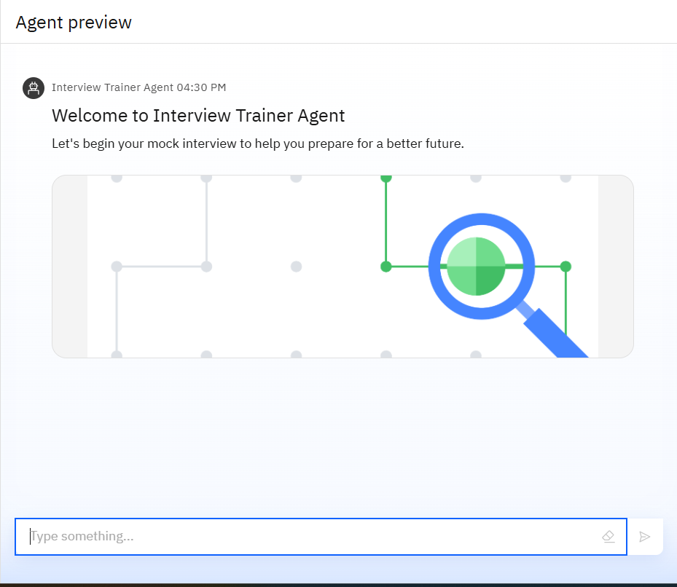
Results
An AI-powered mock interview system for career readiness

Slide 9
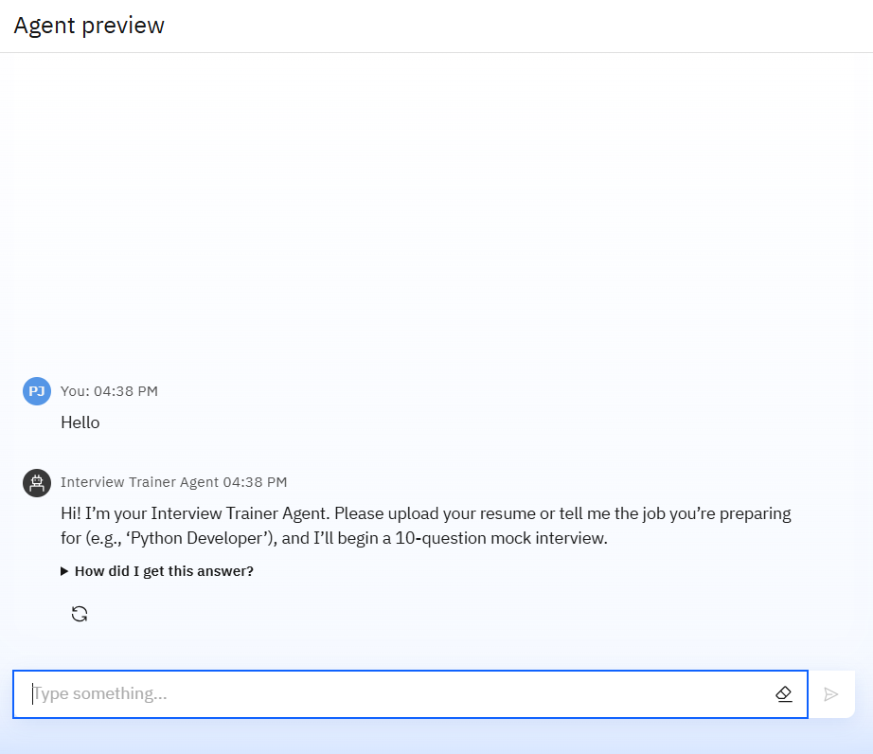
Results
To begin, please enter the topic you wish to be interviewed on or upload your resume

Slide 10
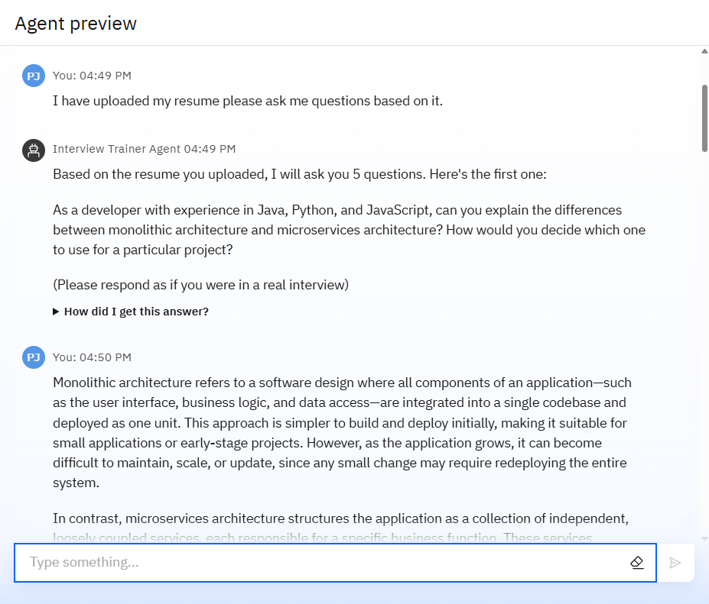
Results
Based on the provided topic, the agent will automatically generate a series of questions for you to answer.

Slide 11
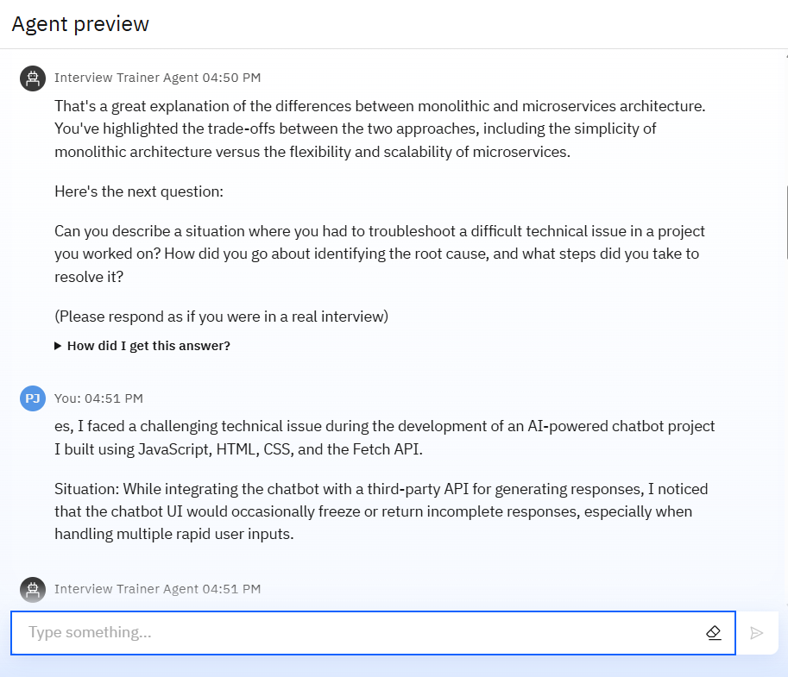
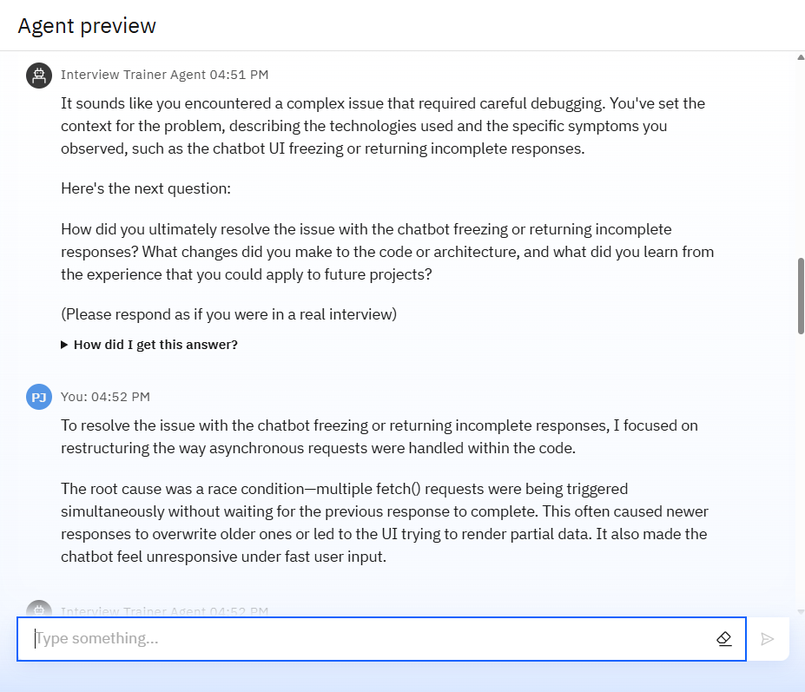
Results

Slide 12
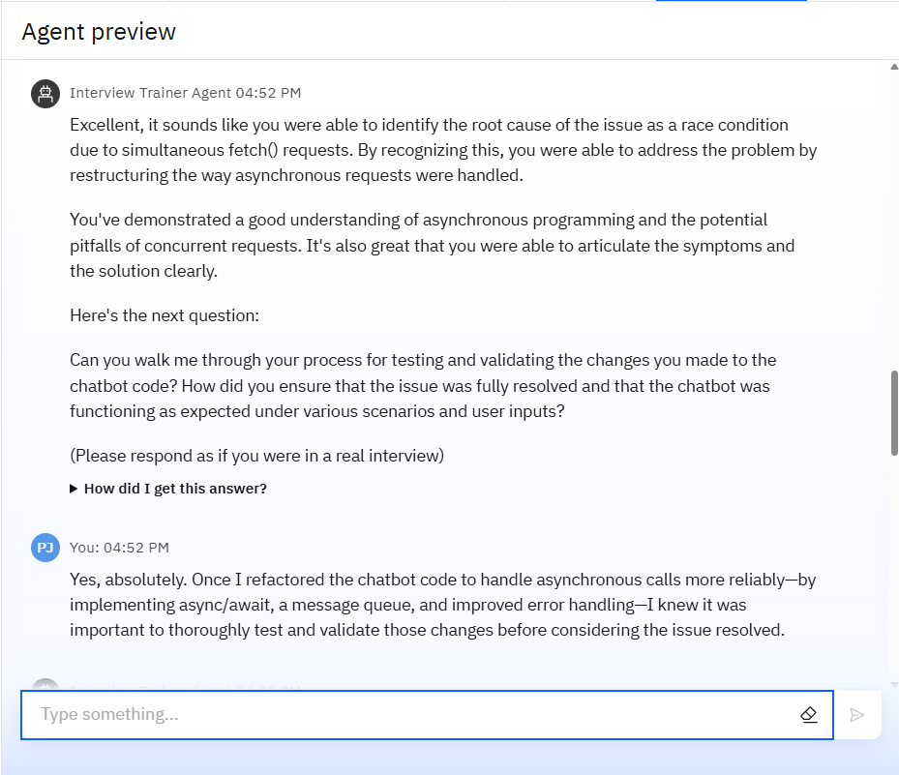
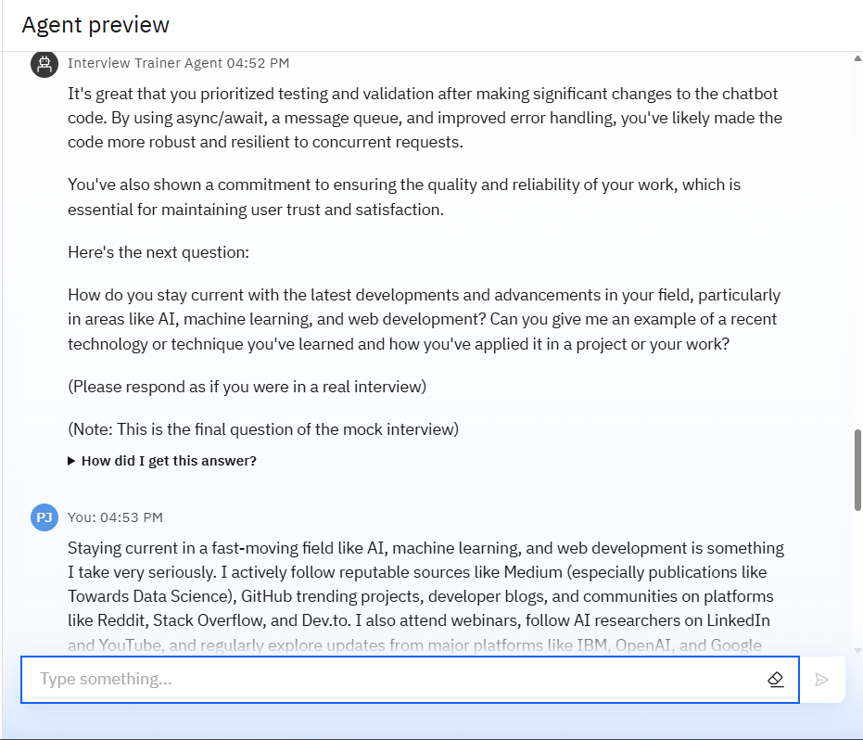
Results

Slide 13
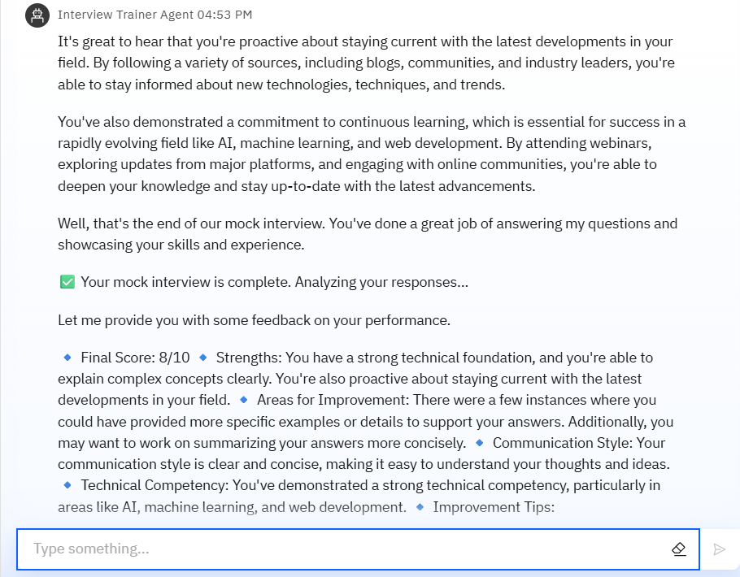
Results

Slide 14
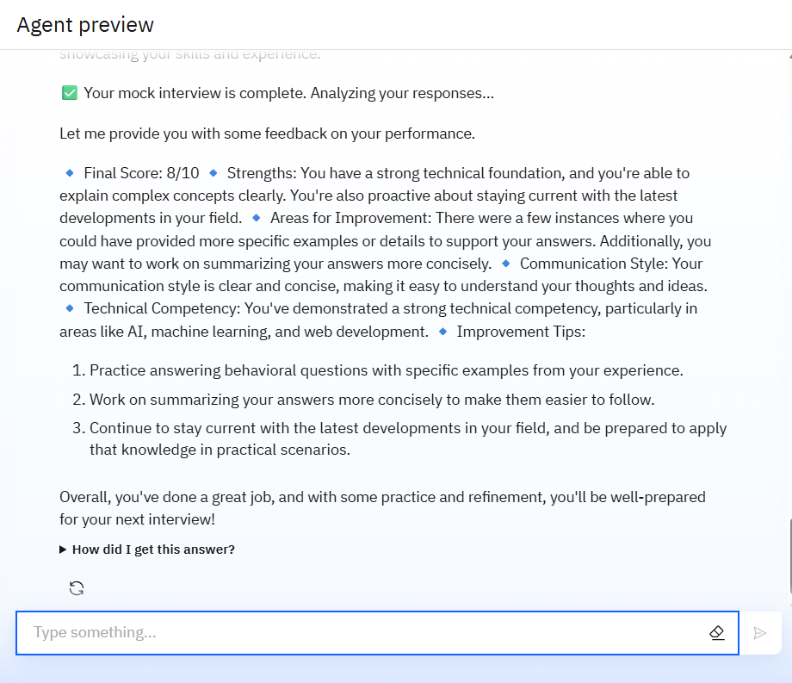
Results
At the end, the agent analyzes your responses and provides a score, detailed feedback, and suggestions for improvement.

Slide 15
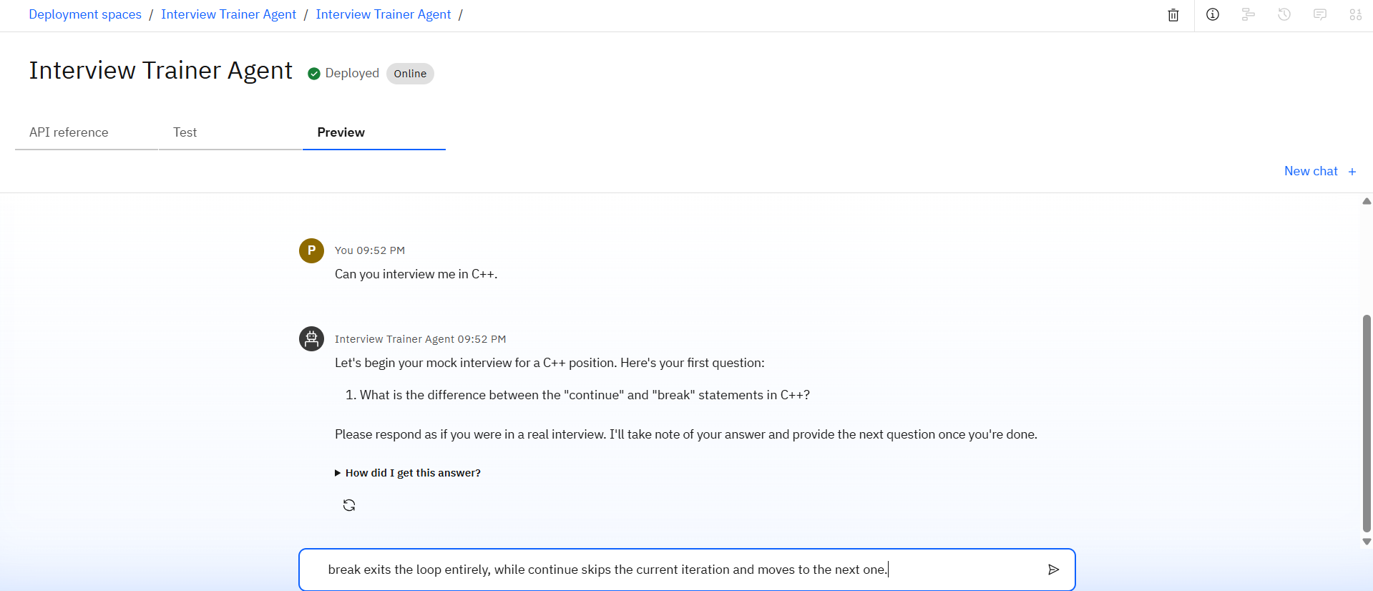
Results
Deployed AI Agent

Slide 16
Conclusion
Personalized Interview Simulation Tailors mock interviews based on user input like job title, resume, or experience level.
Role-Specific Questions Generates technical and behavioral questions relevant to the user’s desired position.
Interactive Interview Flow Asks one question at a time and waits for user response, simulating real-time interview dynamics.
AI-Driven Feedback System After all questions are answered, it evaluates responses and provides a detailed performance report.
Comprehensive Assessment Identifies strengths, weaknesses, communication style, and technical skills.
Actionable Improvement Tips Offers practical suggestions to enhance interview responses and confi.

Slide 17
Future scope
Voice-Based Interview Simulation Integrate speech recognition and synthesis to simulate real-time spoken interviews for better realism.
Video Analysis & Body Language Feedback Use computer vision to analyze facial expressions, eye contact, and body language for deeper feedback.
Multi-Language Support Enable mock interviews in regional and international languages to reach a broader user base.
Adaptive Learning Engine Use user performance history to continuously personalize and improve the difficulty and focus of questions.
Real-Time Coaching Mode Introduce a “Coach Mode” that gives live hints, follow-ups, and answer structuring advice during practice sessions.
Analytics Dashboard Offer detailed analytics on user improvement trends, skill mastery, and readiness over time.

Slide 18
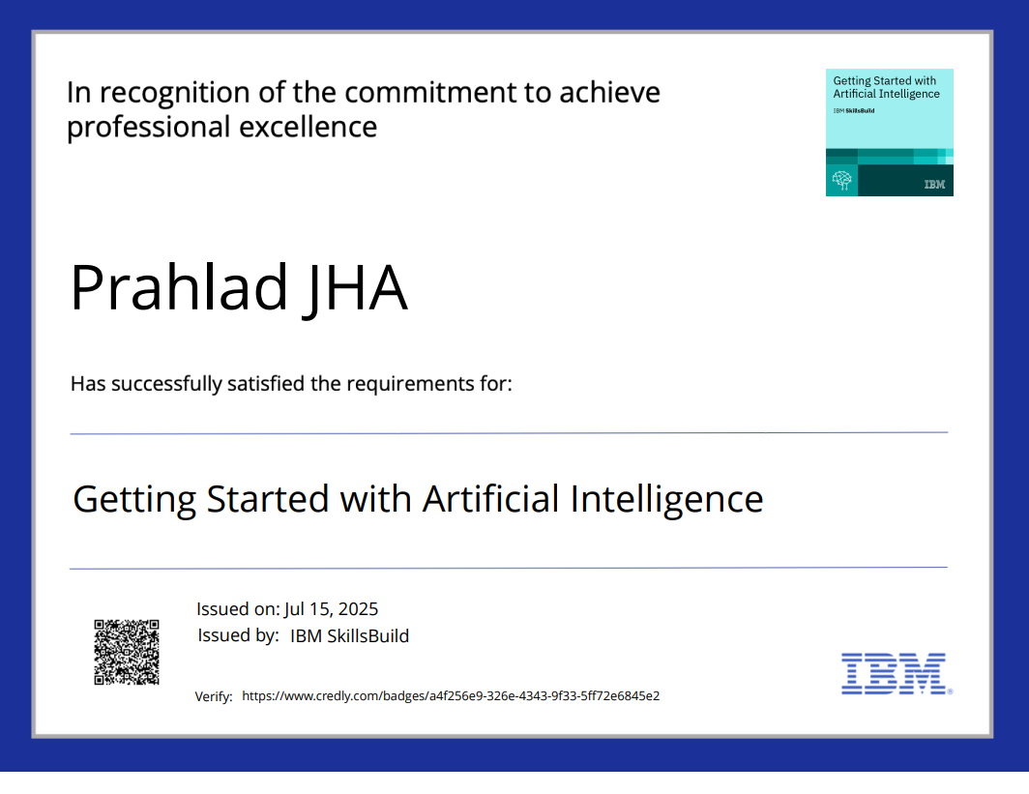
IBM Certifications

Slide 19
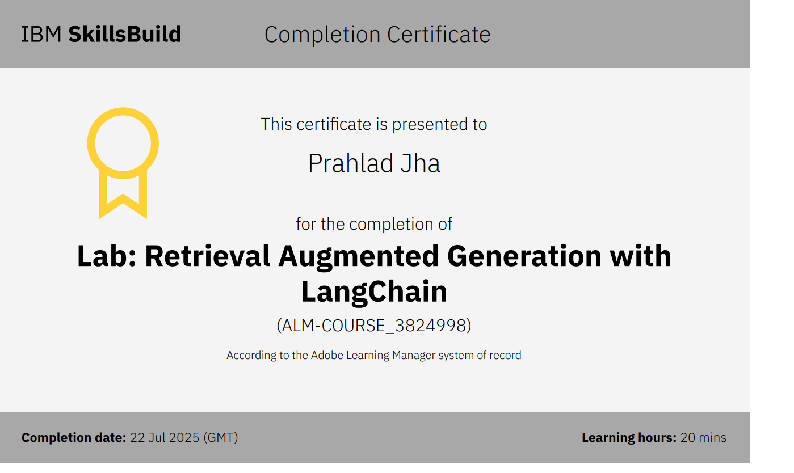

Slide 20


Slide 21
GitHub Link
GITHUB LINK : https://github.com/prahlad-jha/Interview_Trainer_Agent

Slide 22
THANK YOU

